Slide 1
Two-Dimensional Kinematics in Normal-Tangential Coordinate Systems
Dr. Jacob Moore
Associate Professor of Engineering
Penn State Mont Alto

Slide 2
Curvilinear Motion
Curvilinear motion is motion that follows a curved path.
Planar motion (2-D Motion) is curvilinear motion that follows a curve in a single plane
So far, we have dealt with only a single dimension, but to describe curvilinear motion we will need at least 2 dimensions.
Options for these two dimensions include:
Rectangular (horizontal position and vertical position from a stationary origin)
Normal and Tangential Coordinates (rectangular coordinates that are attached to the object in motion)
Polar Coordinates (angle and magnitude of vector from a stationary origin)

Slide 3
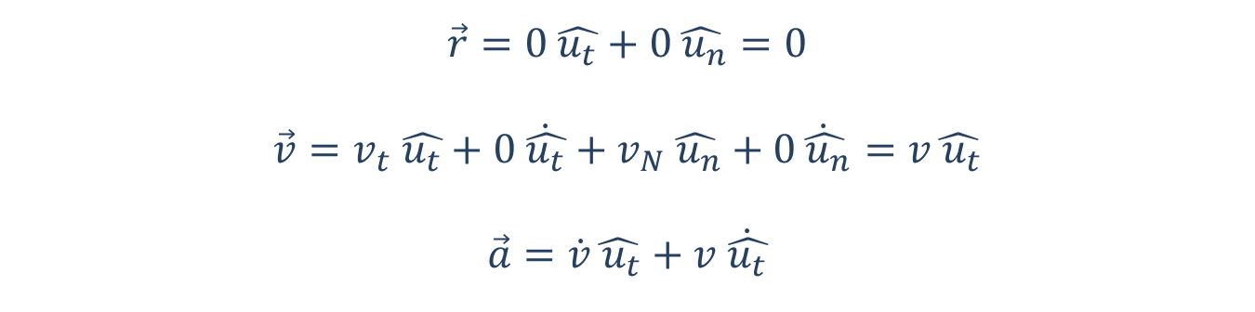



Planar Motion with Normal Tangential Coordinates
$$\vec{r}=0 \hat{u_{t}}+0\hat{ u_{n}}=0$$
$$\vec{v}=v_{t} \hat{u_{t}}+0 \dot{\hat{u_{t}}}+v_{N}\hat{ u_{n}}+0\dot{\hat{ u_{n}}}=v\hat{ u_{t}}$$
$$\vec{a}=\dot{v}\hat{ u_{t}}+v \dot{\hat{u_{t}}}$$
n
$${\hat{u}}_{n}$$
t
$$p$$
$${\hat{u}}_{t}$$

Slide 4



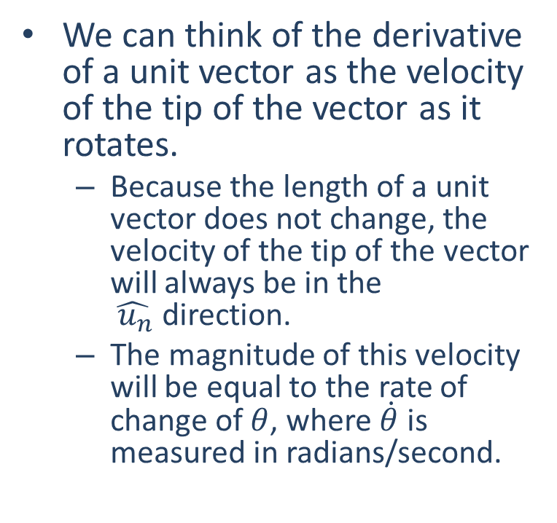




Derivatives of Unit Vectors
$${\hat{u}}_{n}$$
$${\hat{u}}_{n}$$
We can think of the derivative of a unit vector as the velocity of the tip of the vector as it rotates.
Because the length of a unit vector does not change, the velocity of the tip of the vector will always be in the $\hat{ u_{n}}$direction.
The magnitude of this velocity will be equal to the rate of change of $θ$, where $\dot{θ}$ is measured in radians/second.
$${\hat{u}}_{t}$$
$$dθ$$
$${d\hat{u}}_{t}$$
$${\hat{u}}_{t}$$
$$\dot{\hat{u_{t}}}=\dot{θ}\hat{ u_{n}}$$
measured in radians/second
counterclockwise is positive

Slide 5

Planar Motion with Normal-Tangential Coordinates
$$\vec{a}=\dot{v}\hat{ u_{t}}+v \dot{\hat{u_{t}}}=\dot{v} \hat{ u_{t}}+v\dot{θ}\hat{ u_{N}}$$
Or since theta dot will equal speed over radius of curvature…
$$\vec{a}=\dot{v}\hat{ u_{t}}+v\left(\frac{v}{ρ}\right)\hat{ u_{N}}=\dot{v}\hat{ u_{t}}+\frac{v^{2}}{ρ}\hat{ u_{N}}$$
n
$${\hat{u}}_{n}$$
t
$$p$$
$${\hat{u}}_{t}$$

Slide 6


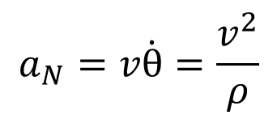

Planar Motion with Normal-Tangential Coordinates
Now that we have all the equations we can break them down into normal and tangential components:
Positions --- Not applicable, we are at the origin by definition.
$$v_{t}=v$$
$$v_{N}=0$$
$$a_{N}=v\dot{θ}=\frac{v^{2}}{ρ}$$
$$a_{t}=\dot{v}$$

Slide 7
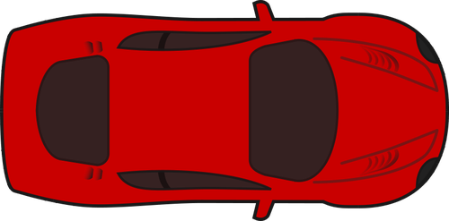



Using Coordinate Systems
t
It’s important to remember that even though these are not the coordinate directions we are used to, they are still just directions and what we are solving for are the components in each direction.
We can take any acceleration vector and break it down into “n” and “t” components just like we break things down into x and y components.
We can also find the overall magnitude using the Pythagorean Theorem and find directions with the inverse tangent function, just as we did with rectangular coordinates
$$a_{n}$$
$$\vec{a}$$
$$a_{t}$$
n

Slide 8
Thanks for Watching
See other engineering mechanics videos and access the full tool at…

Slide 9

Worked Example
A commercial jetliner is traveling a constant 250 m/s when it executes an emergency 180-degree turn. If the turn takes 20 seconds…
What is the acceleration experienced by the passengers?
What is the radius of the curve taken by the plane?

Slide 10
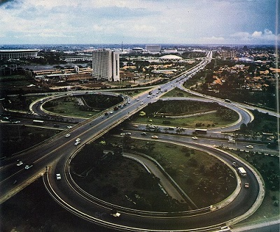
Worked Example
Assuming a cloverleaf interchange has a radius of curvature of 80 meters at the tightest part of the turn, what is the fastest a car could travel around this curve without experiencing more than 1/2 a g in acceleration? (Assume the car is traveling at a constant speed.)
If the car was instead increasing speed at a rate of 2 m/s², what would be the new overall magnitude of the acceleration experienced by the passengers?

